Slide 1
Navigating the Beer Market : Understanding the Competition
Joshua Turk and Matthew David
Notes:
Welcome to today’s presentation where we will be taking a look at some beers and breweries out there on the market.
Increase label size
Add animation
Highlight imputation
Add conclusion

Slide 2
Objectives
Breweries in the states
Median IBU and ABV
Highest alcohol content beer and highest IBU beer
ABV distribution
Relationship between ABV and IBU
IPAs vs Ales
Most popular beer styles
Notes:
So to start out we are going to be looking at how many breweries are in each state
Then we want to get some insight on the median IBU and ABV values
Highlight the highest abv and IBU beers

Slide 3
Missing Values
62 missing values for ABV
1005 missing values for IBU
Inspection reveals that data is missing randomly
We decided to impute the missing data with the overall mean of ABV and IBU
Neither IBU nor ABV are legally required to be on the label
Source: Code of Federal Regulations. "§ 7.65 Labeling of distilled spirits." Electronic Code of Federal Regulations, accessed February 21, 2023, https://www.ecfr.gov/current/title-27/chapter-I/subchapter-A/part-7/subpart-E/section-7.65.
Notes:
Before we move on, we want to address the missing values
The missing values we found were regarding ABV and IBU which appear to be missing at random
This may be caused by the fact that neither IBU nor ABV are legally required to be on the label and in fact were illegal to be on the label un
til 1995 so many places may not measure these
So We decided to input the missing values with their respective means in order to preserve the data that had ABV but no IBU and vice versa

Slide 4
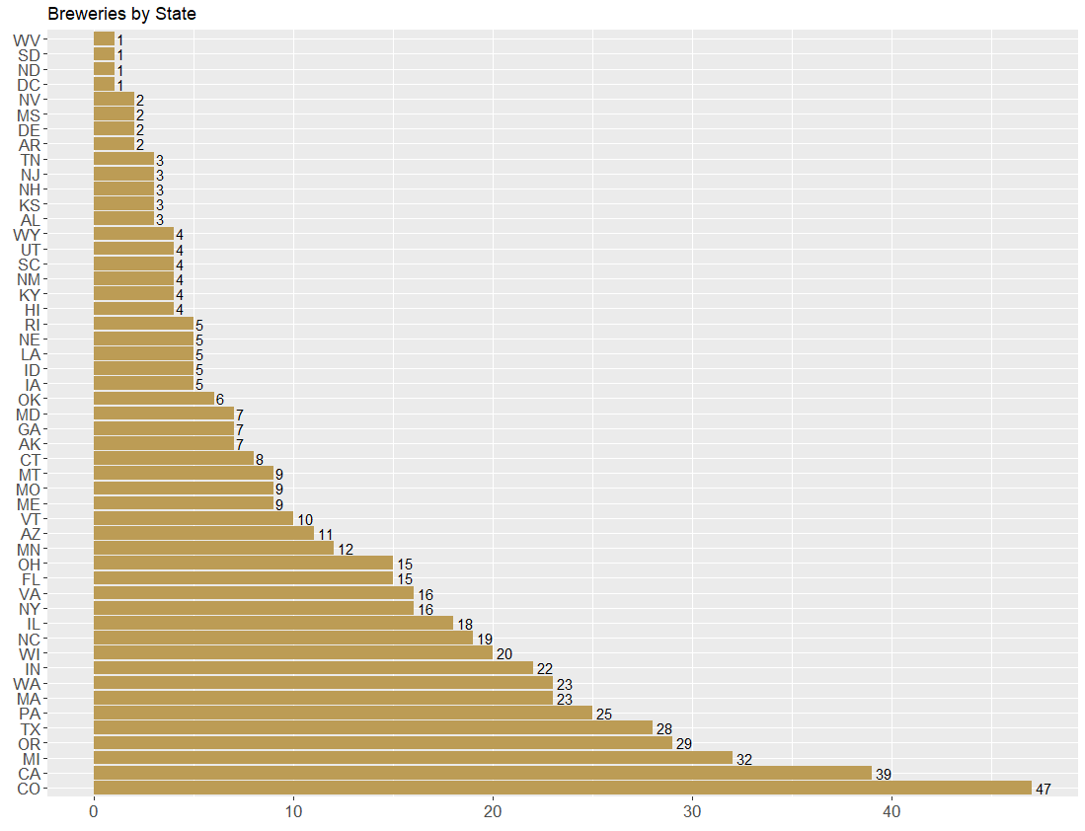
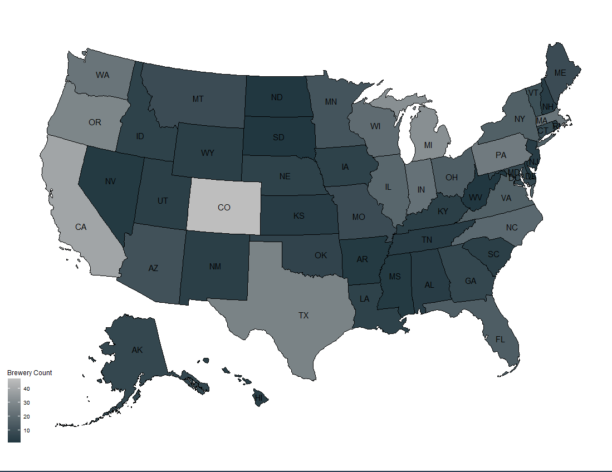
Breweries around the country
Notes:
Here we have a bar chart with the count of breweries in each state
West Virginia, South Dakota, North Dakota, and DC each only have 1 brewery
On the other hand, Colorado has 47 breweries
We also have a heatmap to more easily compare the number of breweries across states

Slide 5
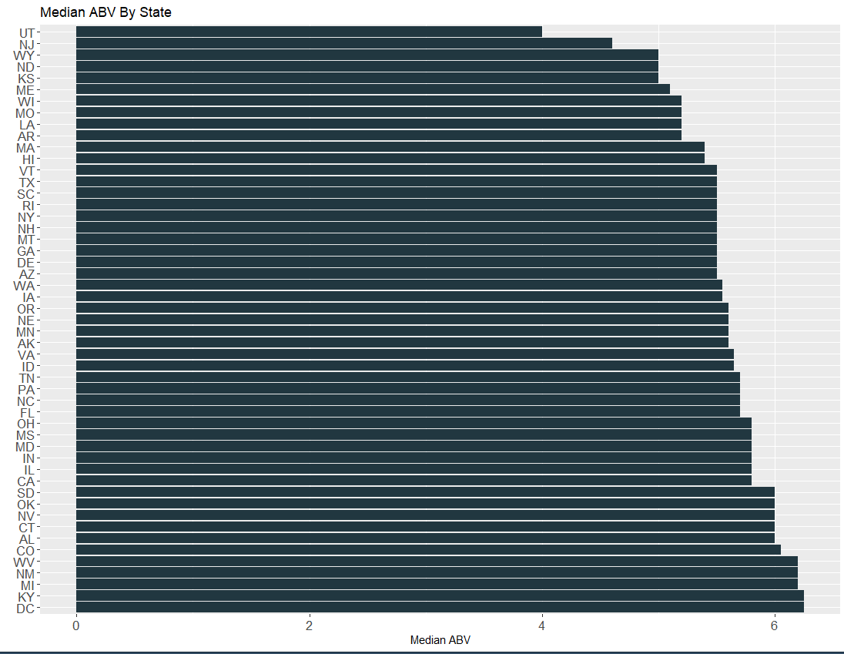
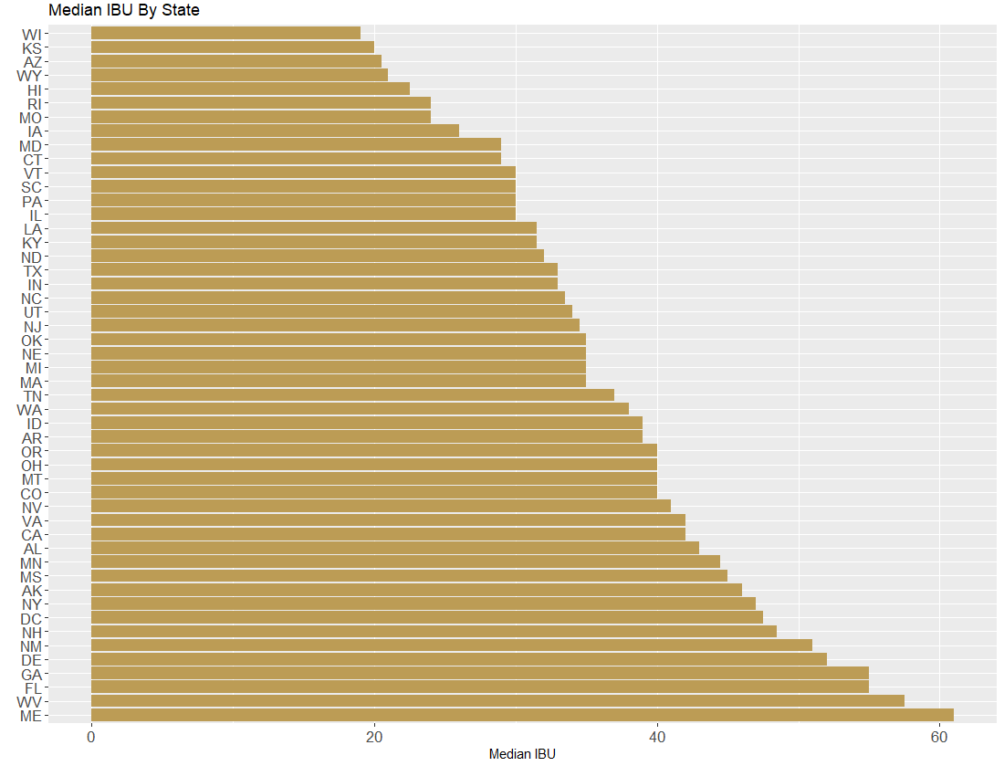
Median IBU and ABV by State
Notes:
Here we can see the median ABVs and median IBUs for each state
ABV has a smaller distribution here than IBU
Utah lowest ABV while DC has the highest
Wisconsin has the lowest IBU and Maine has the highest IBU

Slide 6
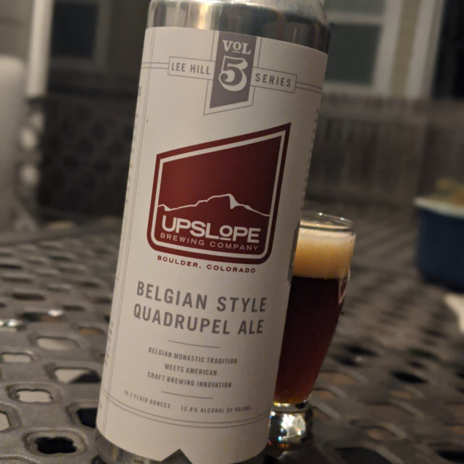
Lee Hill Series Vol. 5
Lee Hill Series Vol. 5 is the highest ABV content in the dataset
From Upslope Brewing Company in Upslope, Colorado
IBU: N/A
ABV: 12.8%
Dauffenbach,Drew “ Lee Hill vol 5- Belgian style quadrupel Ale”https://untappd.com/user/drdrewdown/checkin/955136617, 2018, accessed February, 21, 2023,
Notes:
Now this Lee Hill Series Vol 5 is the highest ABV beer we have in this dataset with an ABV of 12.8%
For comparison, the mean of all beers in the dataset is 6%
From Upslope Brewing Company in Upslope, Colorado
We didn't have an IBU in the data for this beer

Slide 7
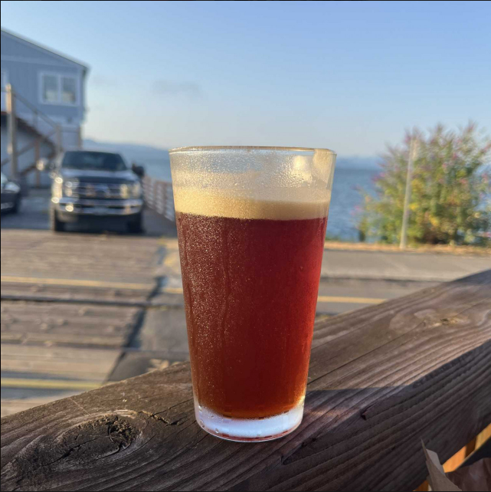
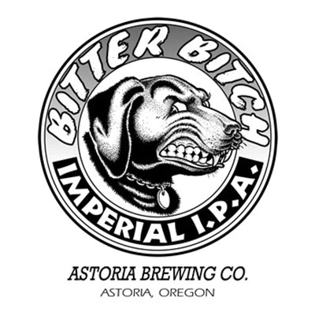
Bitter Bitch Imperial IPA
The Bitter Bitch Imperial IPA is the bitterest beer in the dataset
From Astoria, Oregon
IBU: 138
ABV: 8.2%
Margavio, Keith “ Bitter Bitch Imperial IPA” https://untappd.com/user/kmargavio/checkin/1185083420, 2022, Accessed February, 21,2023.
Runningman “ Astoria Bitter Bitch IPA ⅙ BBL”https://runningmanpdx.com/products/astoriabitterbitchiipa1-6bbl, Accessed February, 21,2023.
Notes:
Bitter Bitch Imperial IPA has the highest IBU measurement
this comes from Astoria Brewing in Astoria, Oregon
With an ABV of 8.2% and an IBU of 138, Again for comparison the mean IBU of the dataset is 43.

Slide 8
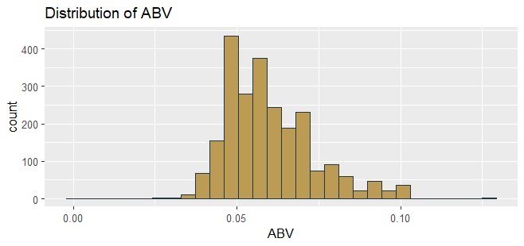
ABV Distribution
Mean | 5.977%
Min | 0.1%
Q1 | 5%
Median | 5.6%
Q3 | 6.7%
Max | 12.8%
Notes:
Now to talk a little more about ABV
Here we can see that the mean ABV is about 6% and we have some pretty right skewed data, not many beers out there less than 4% or so
Our minimum is 0.1%, which in many states is considered alcohol free
Our max is 12.8% which is the Lee Hill Series Vol. 5

Slide 9
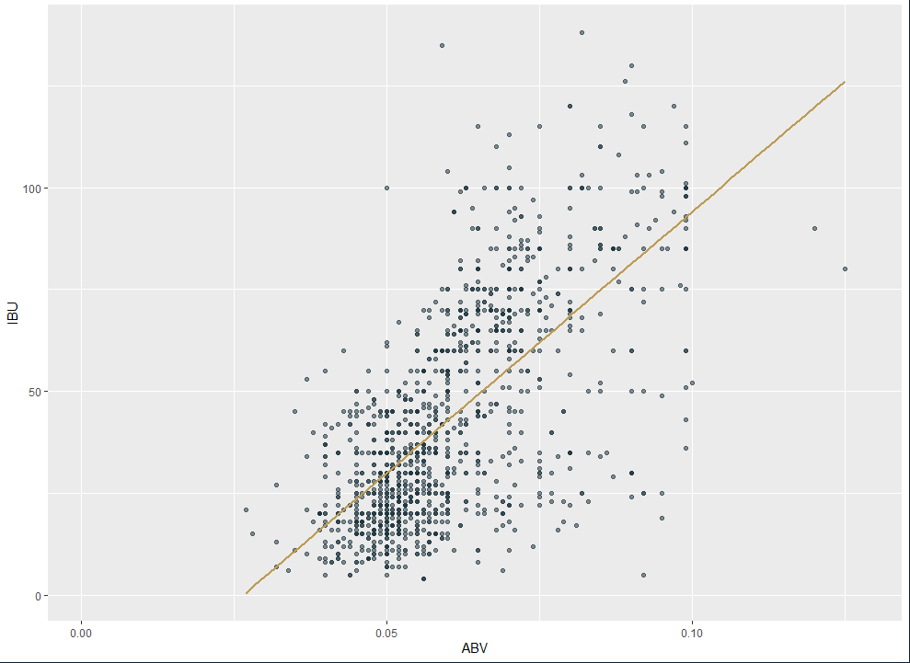
Relationship Between ABV & IBU
R-squared: 0.2704
Notes:
Finally we wanted to look at the relationship between ABV and IBU
So here we have a scatter plot with a linear trendline
We can see that relationship is positive in nature and we have an R2 value of 0.27
Meaning about 27% of the variance in one variable can be explained by the other
But in general, beers with higher IBUs will have a higher ABV, although this relationship isn't the strongest
And thats all we have for today, thank you so much for your time.

Slide 10
Ales vs IPAs: Relations to ABV and IBU
Accuracy: 83.3%
Average Accuracy over 10 iterations: 81.6%
Ale Positive Rate (Sensitivity) : 88.05%
IPA Positive Rate (Specificity): 75.00%
High Accuracy
IBU and ABV are big in defining IPAs and Ales
Classifications | Ale | IPA
Ale | 258 | 42
IPA | 35 | 126
Notes:
Next we wanted to look at the difference between IPAS and Ales with respect to ABV and IBU
We decided to create a kNN model to measure this
As you can see the model correctly predicted the beer 83.3% of the time
With this accuracy we can be confident that the difference between Ales and IPAs can be very well defined by just a beers ABV and IBU measurements

Slide 11
Popular Styles around the U.S.
Style | Count
American IPA | 424
American Pale Ale | 245
American Amber / Red Ale | 133
American Blonde Ale | 108
American Double/ Imperial IPA | 105
We found the top 5 most popular beer styles by count
American IPA was the most popular with a count of 424
We decided to look at the most popular style for each state
Notes:
So finally we wanted to look at the most popular styles of beer in the us
We found the top 5 most popular styles by count and the American IPA was by far the most popular style with a count of 424 and the next most popular style is the american pale ale with a count of 245 followed by the american amber, the american blonde and the american double IPA.

Slide 12
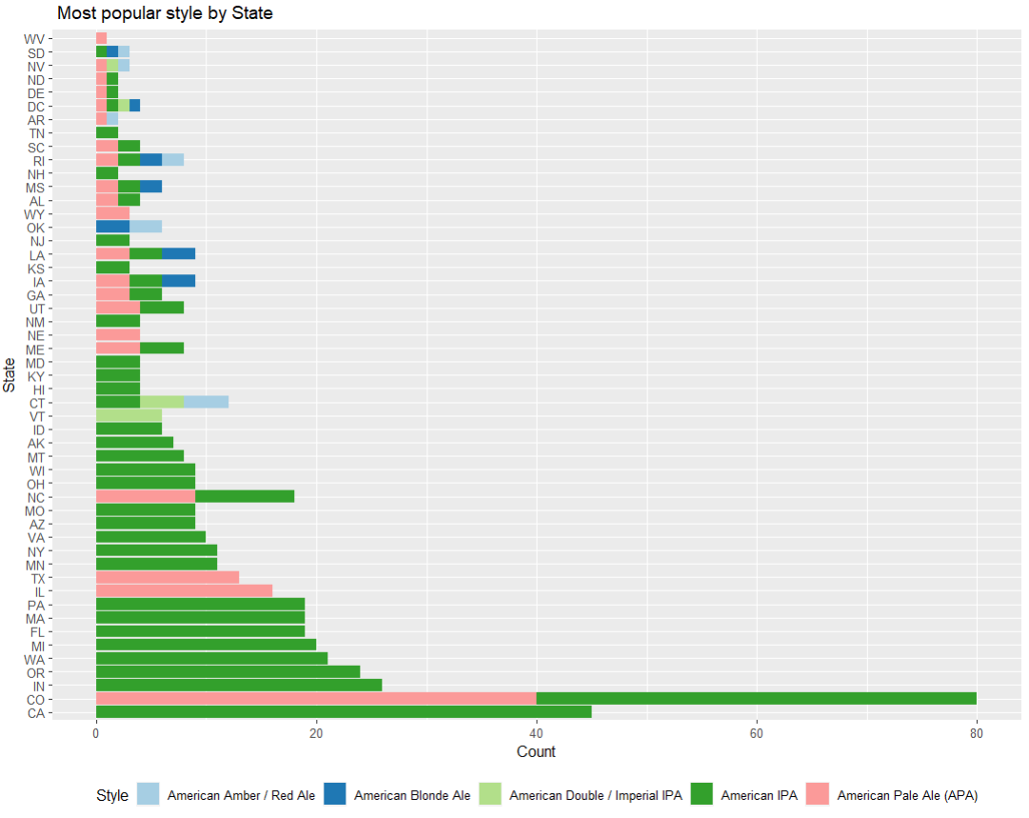
American IPA was the most popular style in 26 states
Split favorite in 15 additional states
Style split
Notes:
Here we can visually see which states these top styles are coming from
For clarity, the different colors represent a tie in the most common style of the top 5 beers in each state
For instance we have colorado which had 40 IPAs and 40 Pale ales and we have a tie in 15 states

Slide 13
Thank you for your time!
Contact Information
Josh Turk - jturk@smu.edu
Matthew David - matthewdavid@smu.edu
Github Repository
https://github.com/Josh-Turk/Beer-and-Breweries-EDA
YouTube Presentation:
https://www.youtube.com/watch?v=T6lSoQ4JIsI
Notes:
Thats all we have for today, thank you so much for your time!
If you wqould like to contact either me or MAtthew feel free to reach us at our emails shown here
And if you would like to take a closer look at how we arrived at these insights please take a look at this github repository.
Again thank you so much for you time.

